Slide 1

How to control an LCD Display with a Raspberry Pi

Slide 2
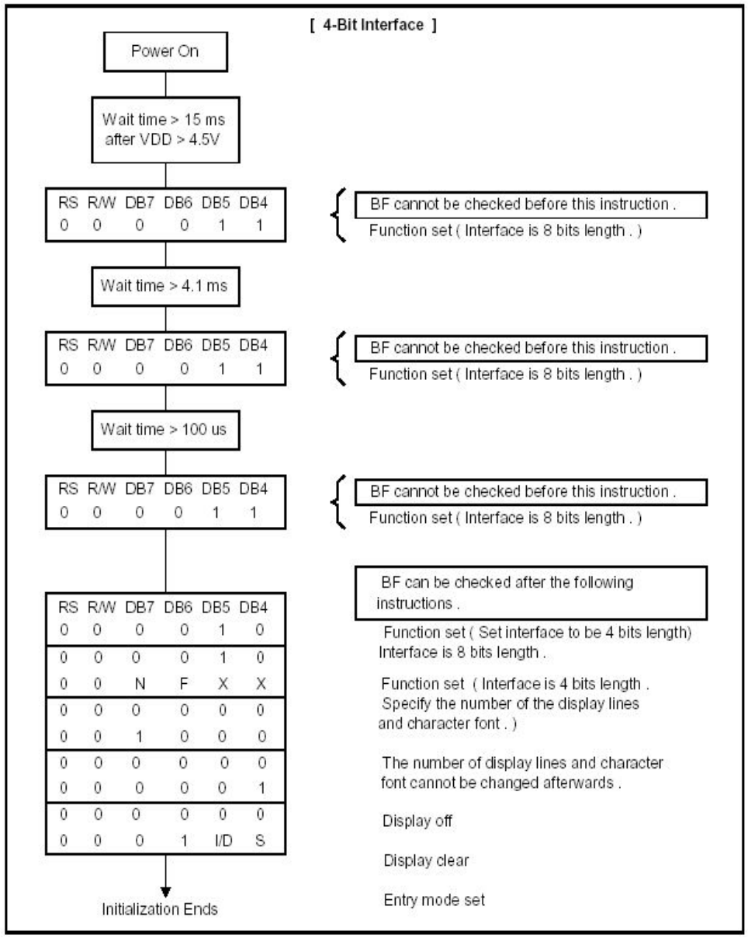
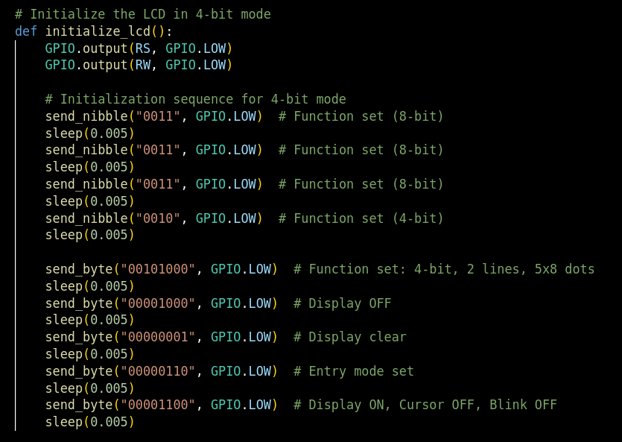
Initialization Sequence

Slide 3
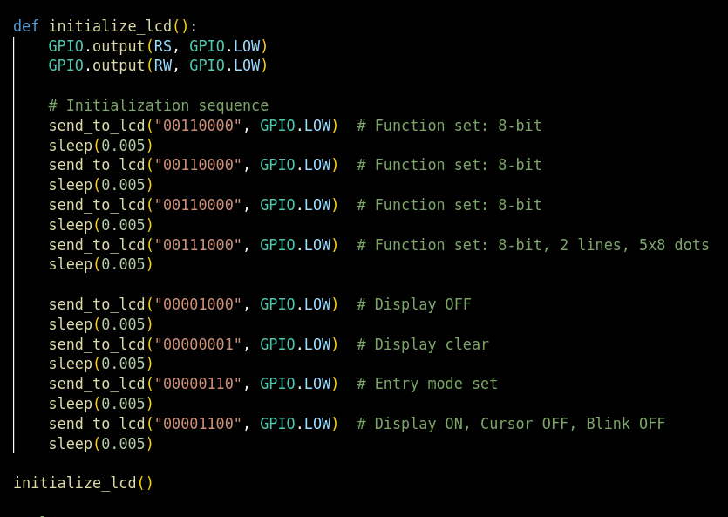
Initialization Sequence for 8 Bit vs 4 Bit Mode
8 Bit Mode
4 Bit Mode

Slide 4
Raspberry Pi to LCD Wiring Layout

Slide 5
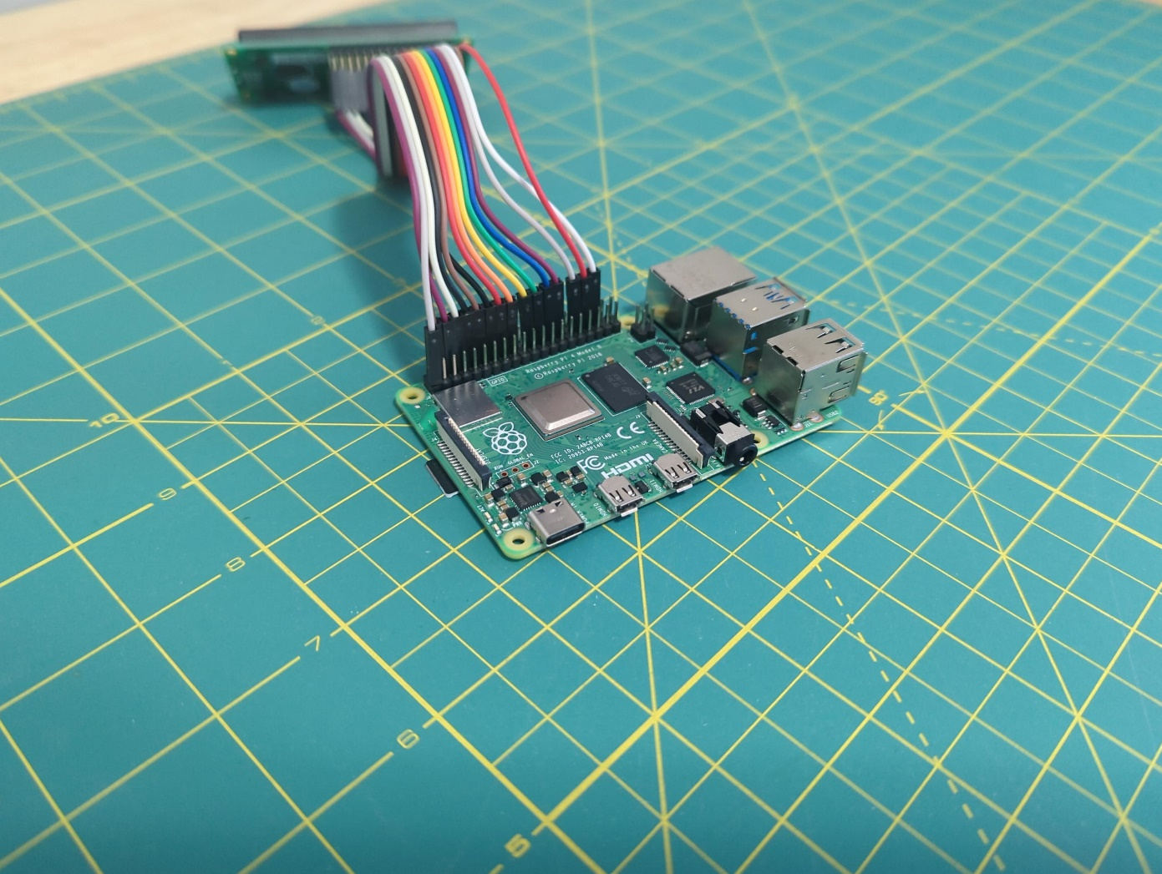
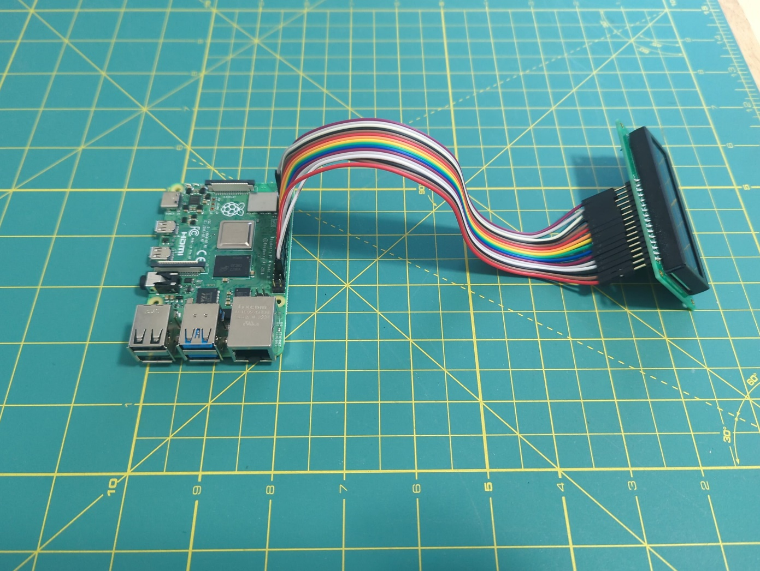
Raspberry Pi to LCD Wiring Layout

Slide 6
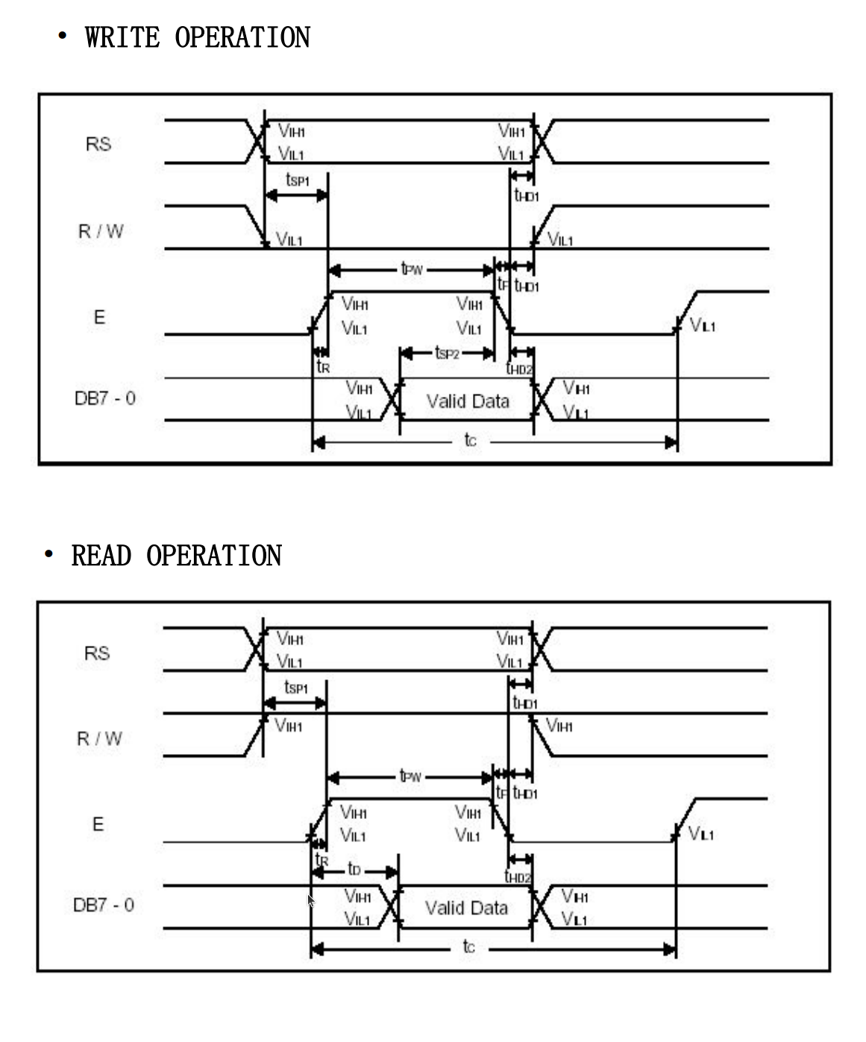
Timing Diagram
Timing Diagram for LCD
What is a Timing Diagram?
Definition: A graphical representation that shows the relationship between different signals over time.
Purpose: Helps visualize the sequence and duration of signals required to operate an LCD.
Key Components:
Signals: Represented by lines or waveforms that switch between HIGH (1) and LOW (0) states.
Time Axis: Horizontal axis showing the progression of time.
Signal Transitions: Indicate when and how signals change states.
Usage in LCD Control:
Command/Data Signals: Shows when to send commands or data.
Enable Signal (E): Indicates when the LCD should read data from the data bus.
Read/Write Signal (RW): Specifies whether to read from or write to the LCD.
Register Select (RS): Determines if the data is a command (LOW) or display data (HIGH).
Example:
Enable Pulse: A short HIGH state on the Enable (E) signal line to latch data.
Data Valid: Data must be stable during the HIGH state of the Enable signal.

Slide 7
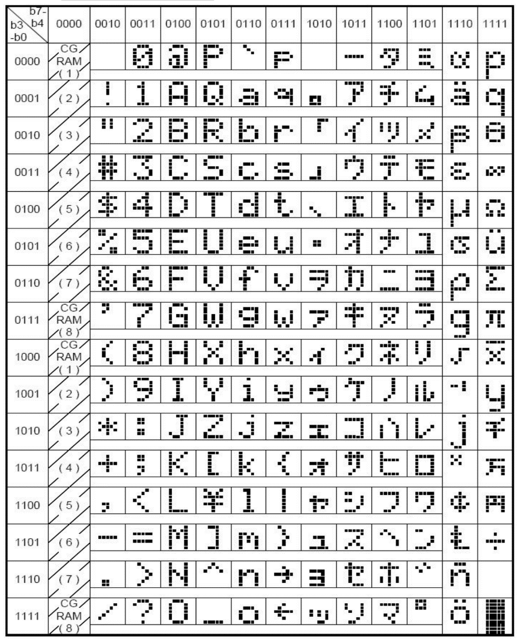
ASCII In Binary
Using Binary for ASCII on an LCD with Raspberry Pi
Binary Basics
Binary System: Uses 0 and 1 to represent data.
Example: Binary 1010 = Decimal 10.
ASCII Overview
ASCII Code: Maps characters to binary numbers (0-127).
Example:
'A' = 65 in decimal = 01000001 in binary.
'a' = 97 in decimal = 01100001 in binary.
Sending ASCII to LCD
Convert Character to ASCII: 'H' = 72.
Convert ASCII to Binary: 72 = 01001000.
Send Binary to LCD: Use GPIO pins on Raspberry Pi.

